Slide 1
Center pivot + planet imagery
Jan 31, 2019

Slide 2
Center pivot

Slide 3
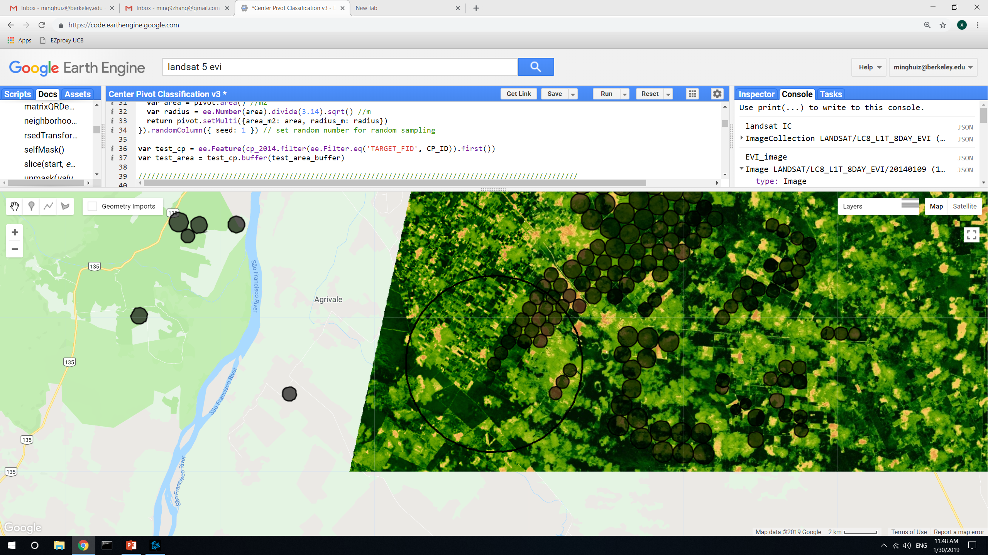
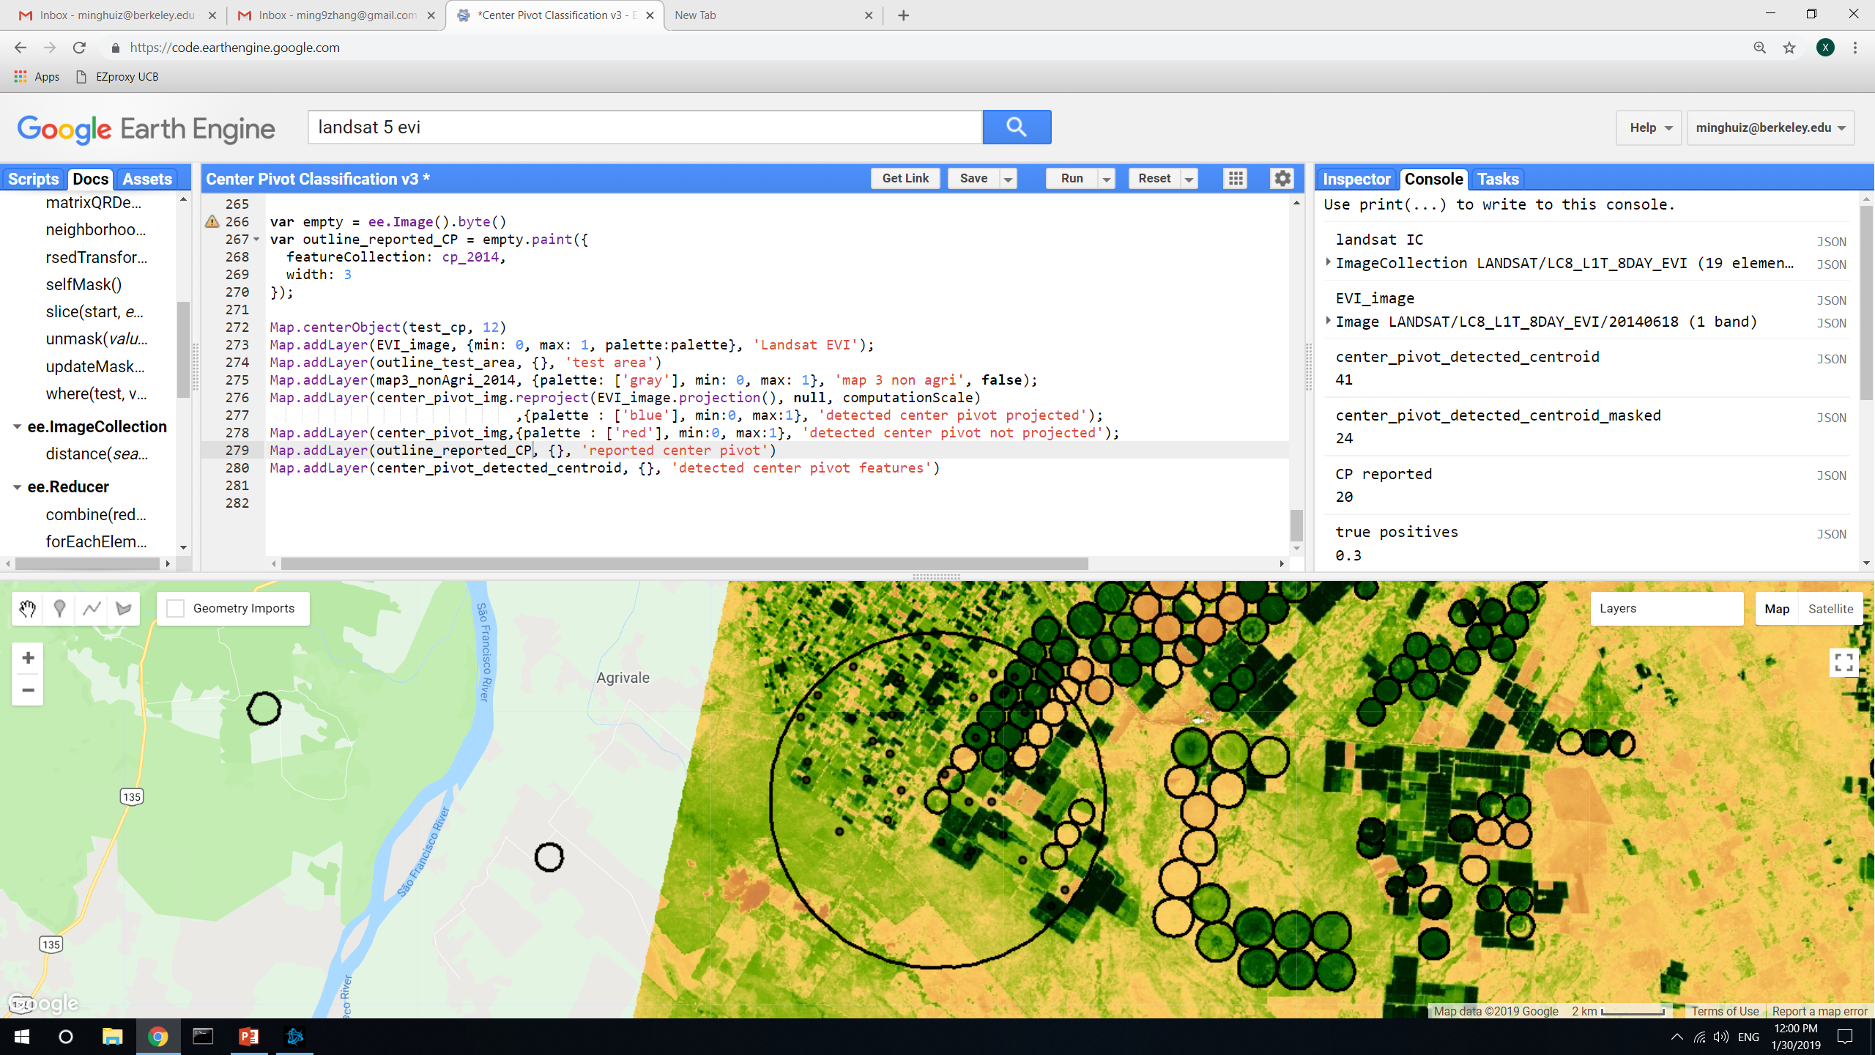
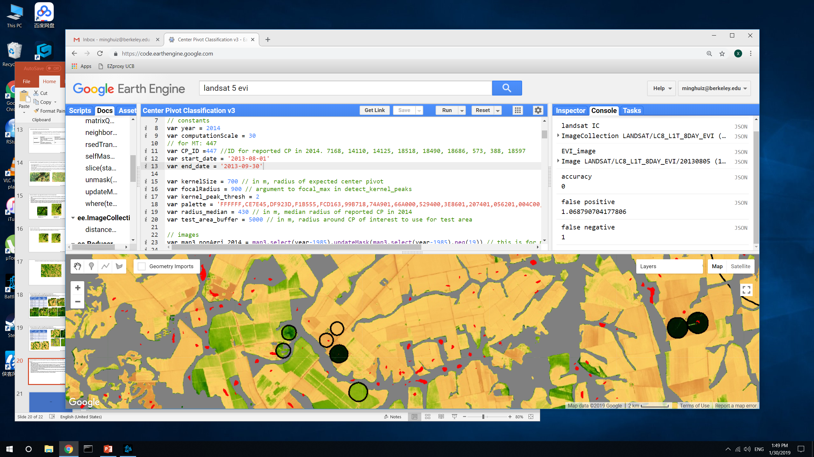
Center pivot detection: just use 2014’s reported CP to get only nonirrigated pixels during or before 2014
Date of max variance in EVI doesn’t give the most ‘optimal’ image for center pivot detection, even after masking out nonagricultural areas. Heterogeneous fields can dominate EVI variance throughout the growing season
Maximum EVI variance image over various time spans never produce an acceptable result
Before masking nonagri
Date: Jan 9
Area accuracy: 0.25
Before masking out nonagri, the chosen image doesn’t clearly show center pivots
Masking out nonagri
Date: June 18
Area accuracy: 0.27
False negatives are high because center pivots might be staggered so there’s no ‘yellow’ space between the ‘green’
red dots = detected center pivot
False positives can’t be masked out by any feature that’s unique to rainfed agri

Slide 4
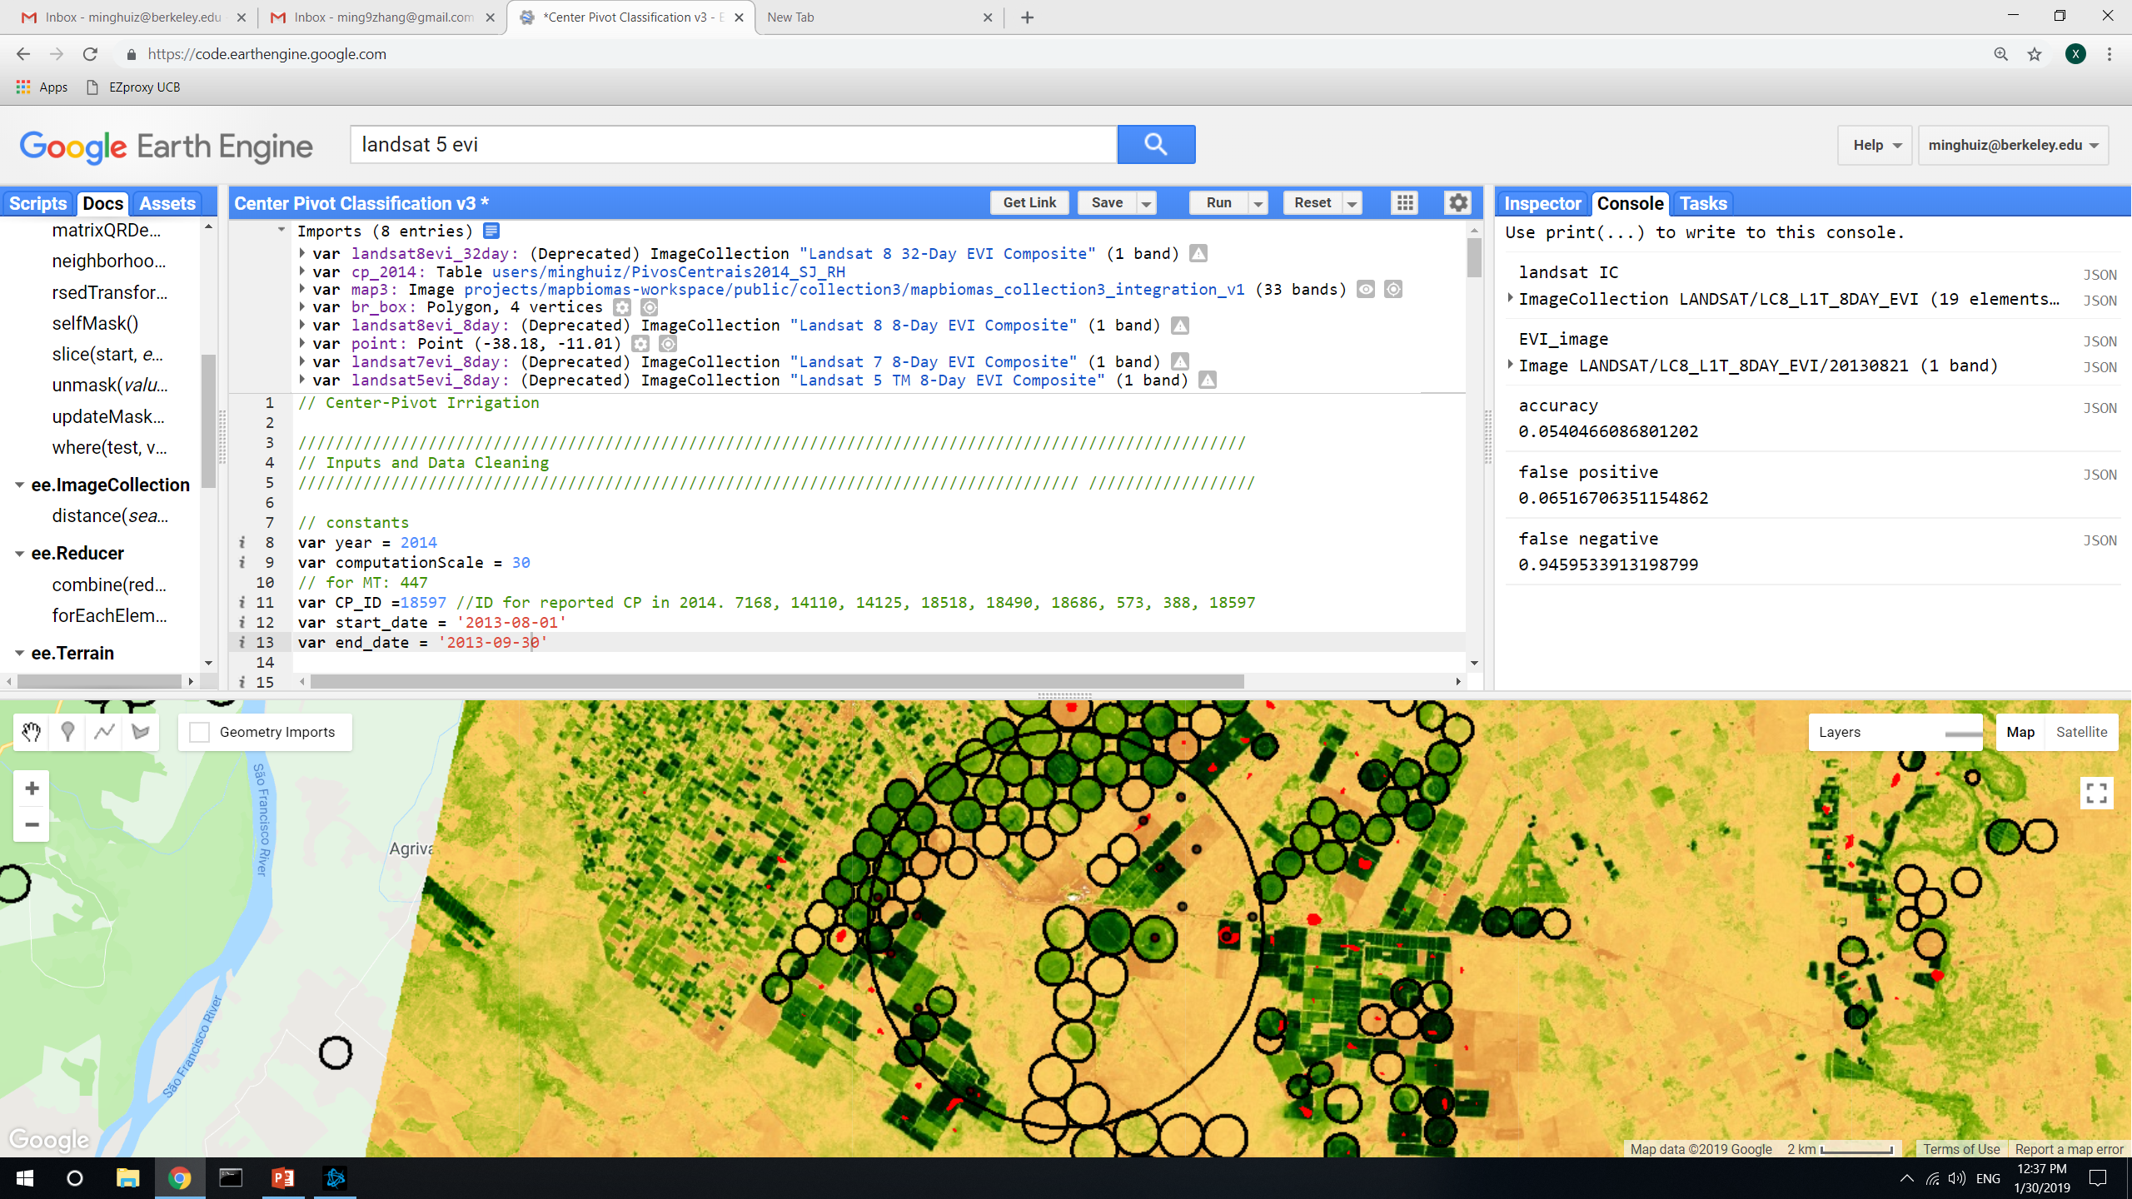
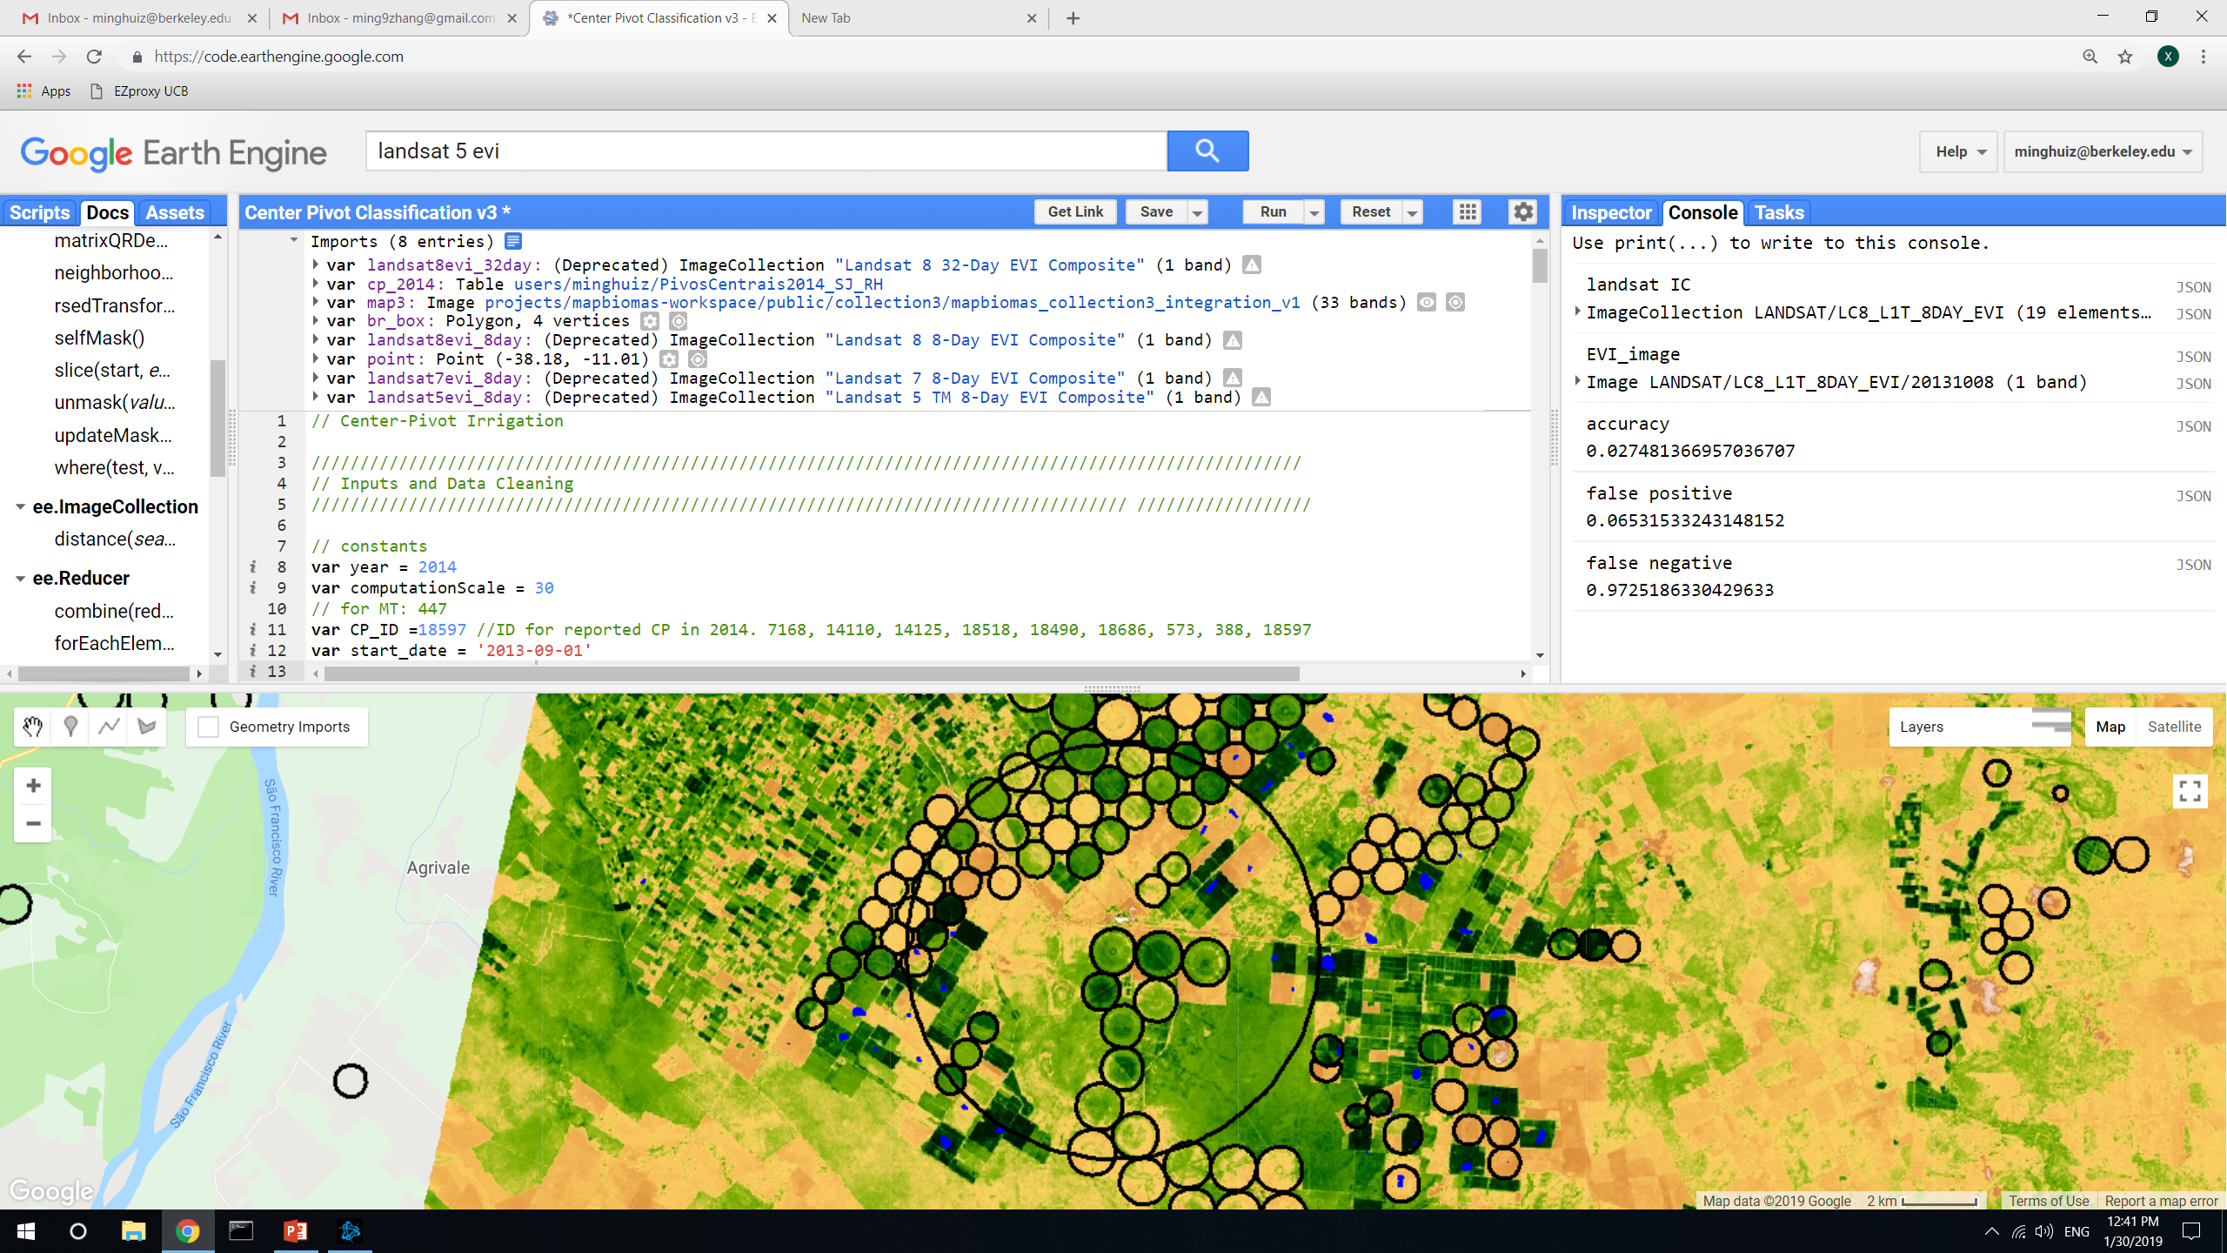
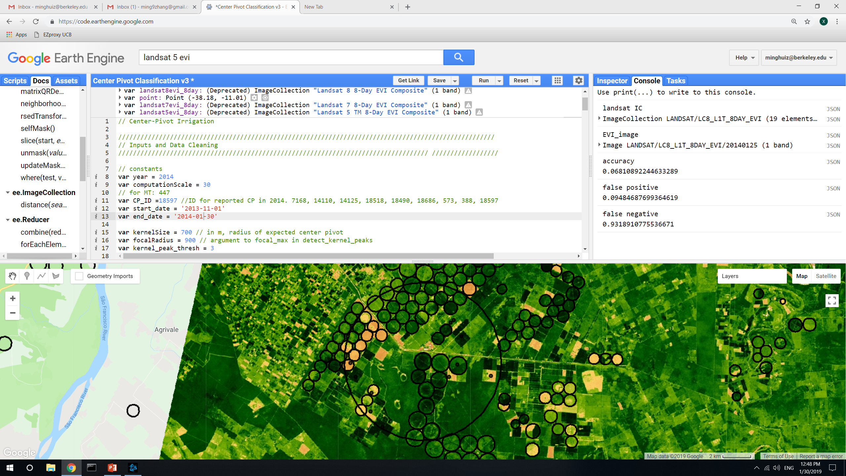
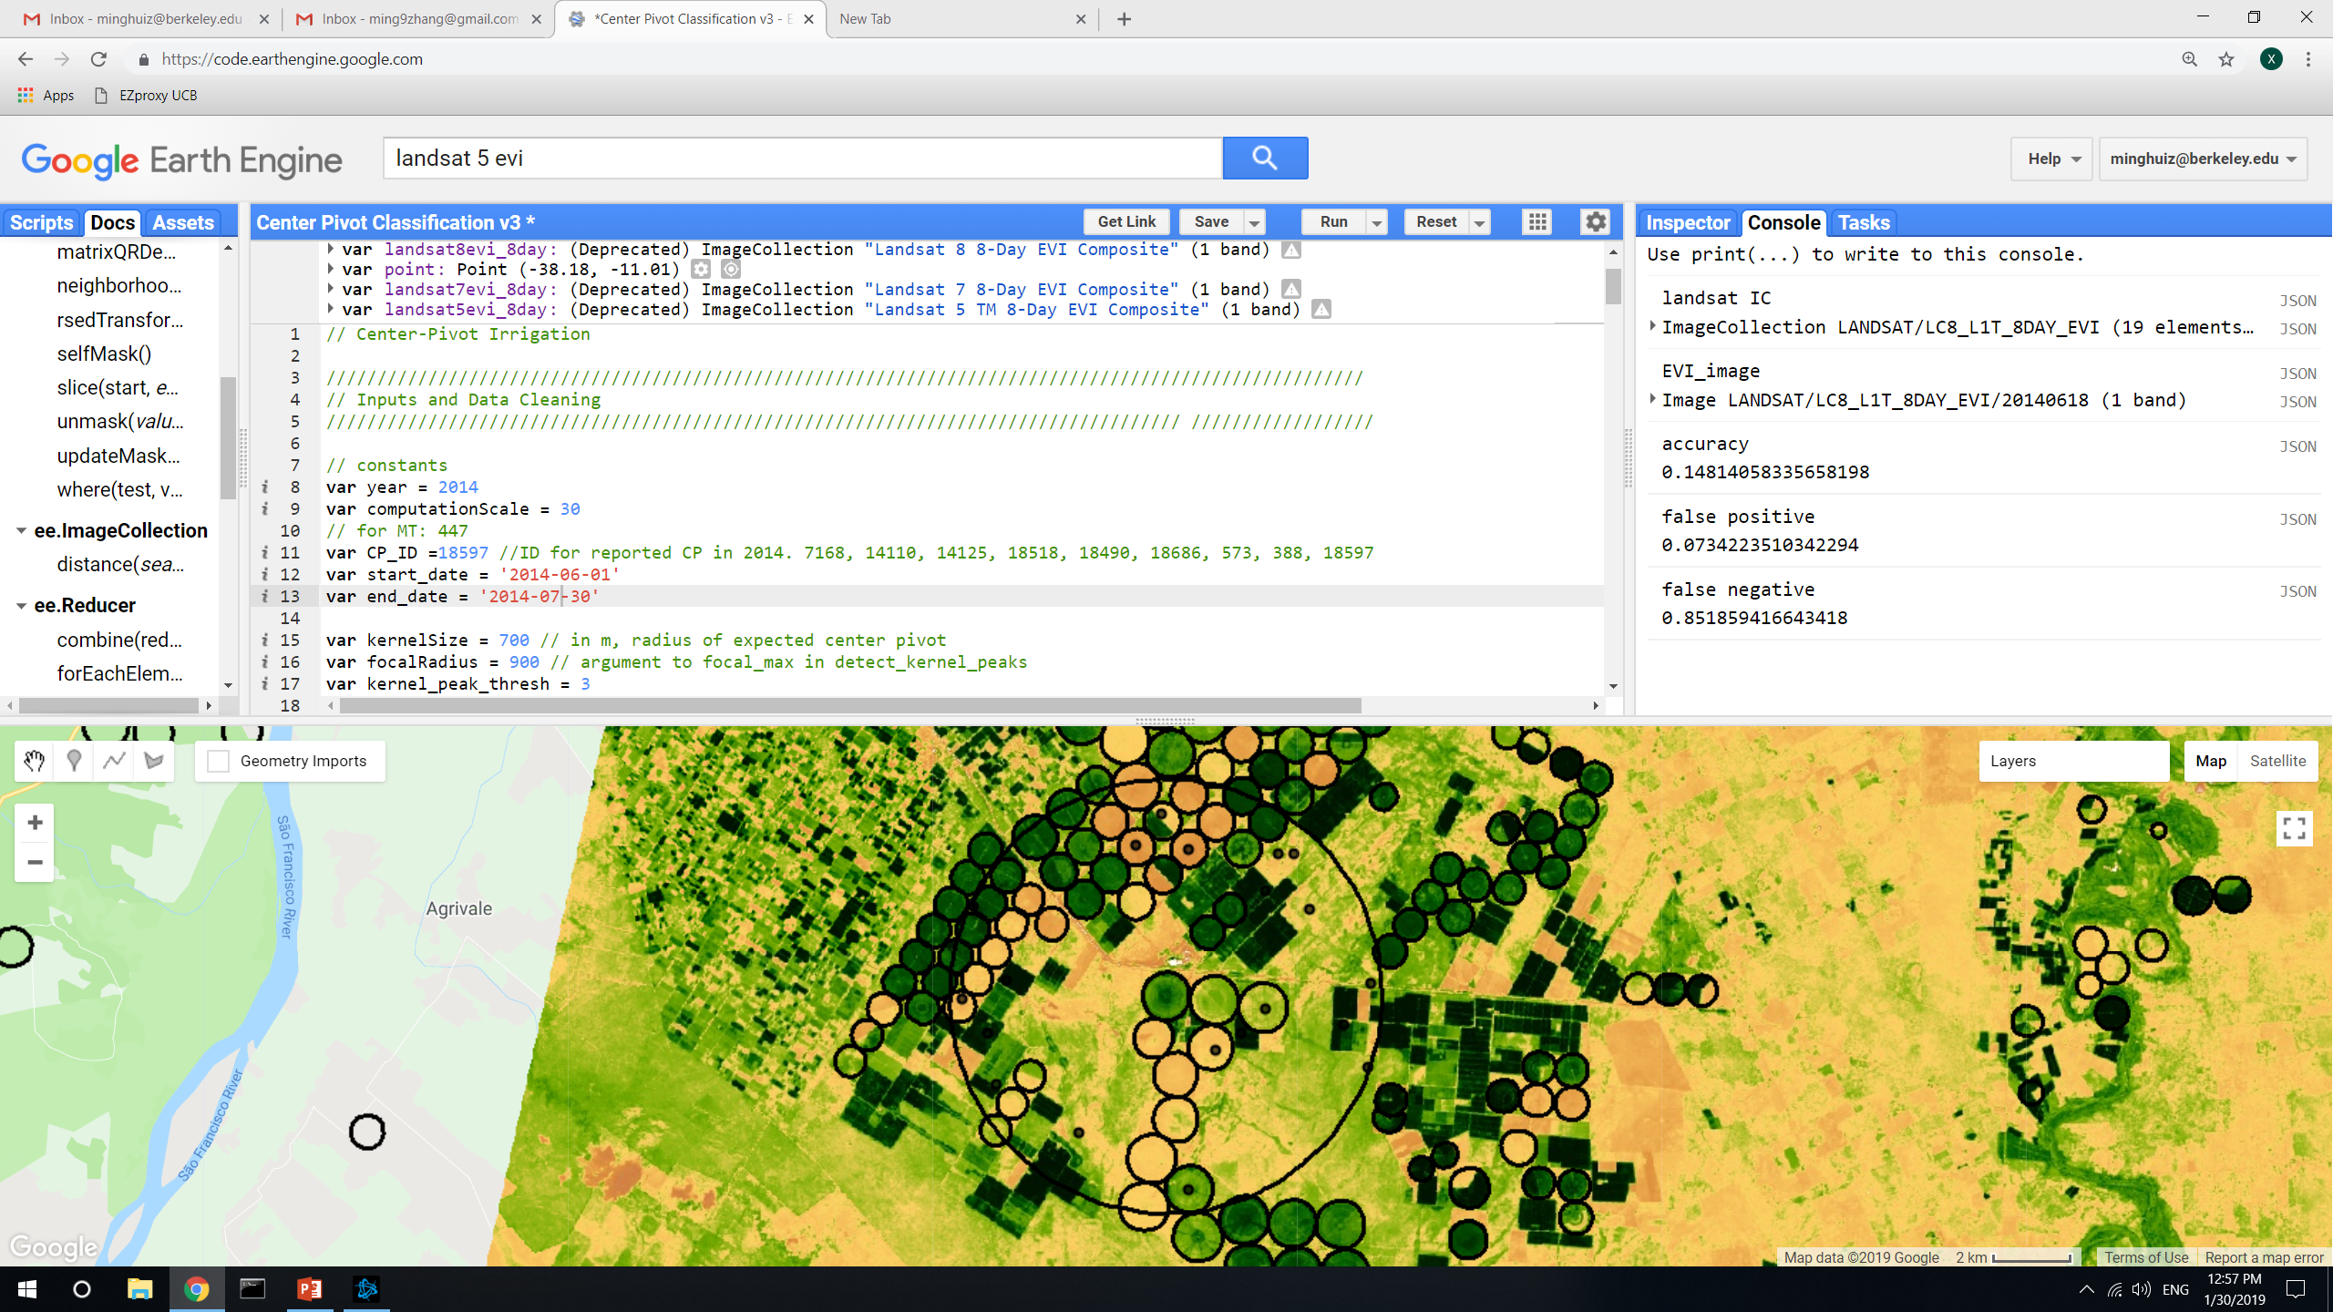
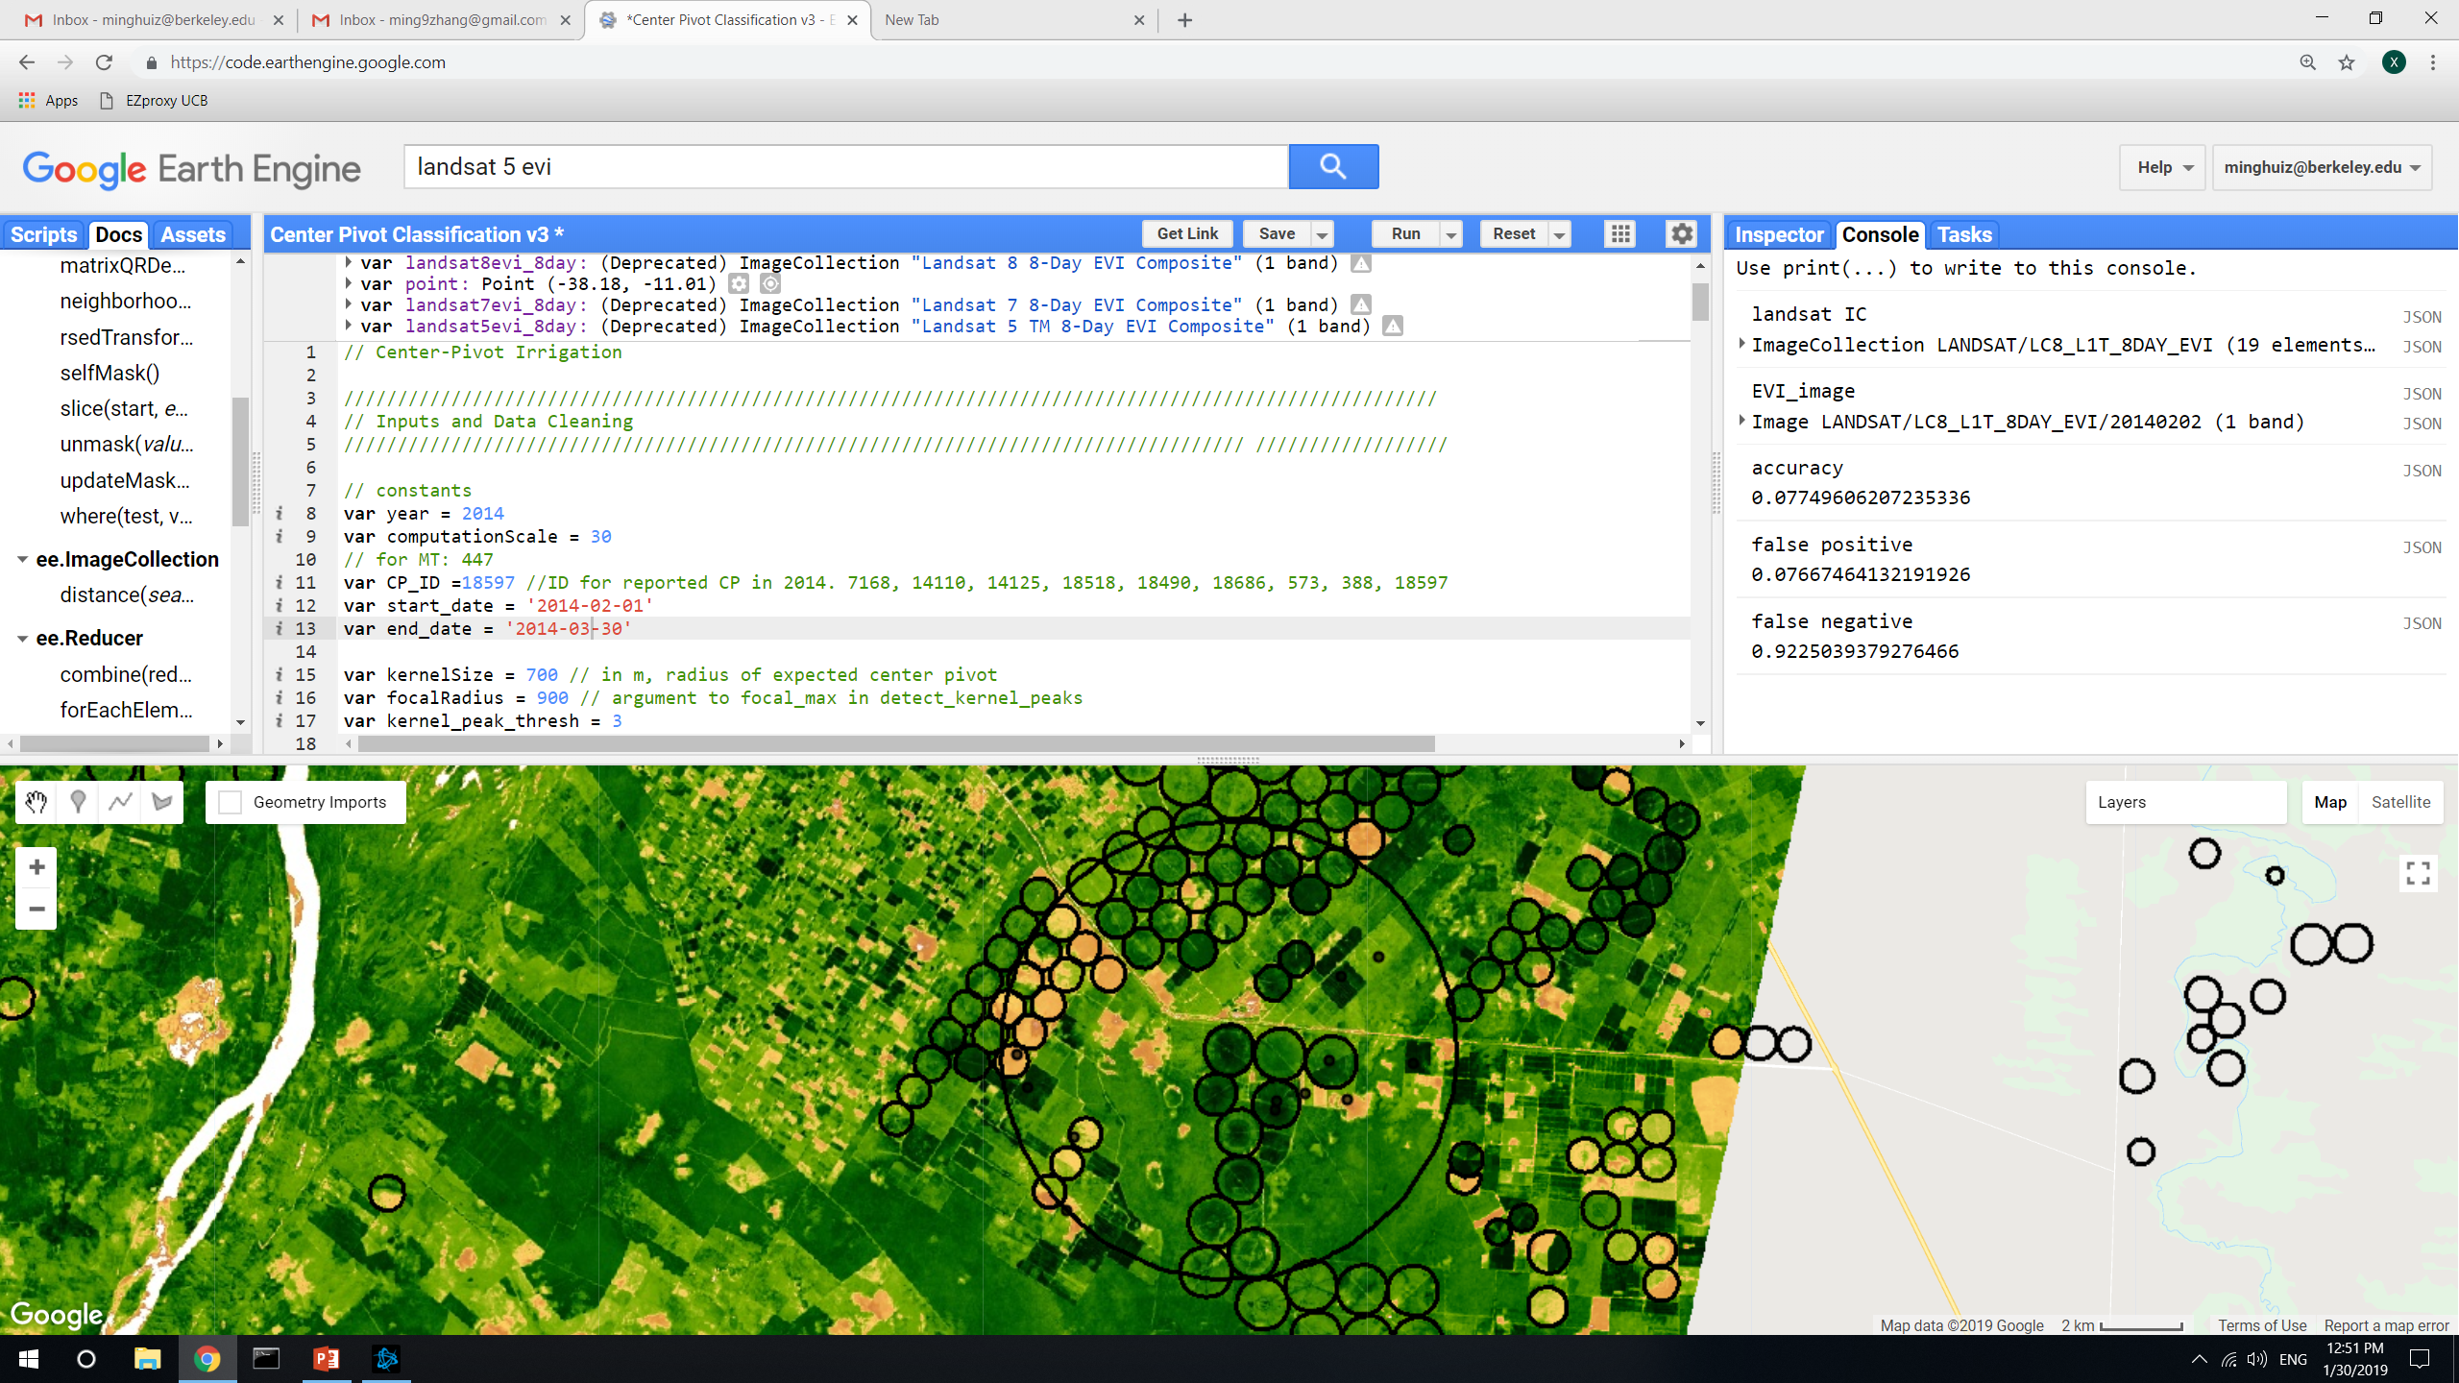
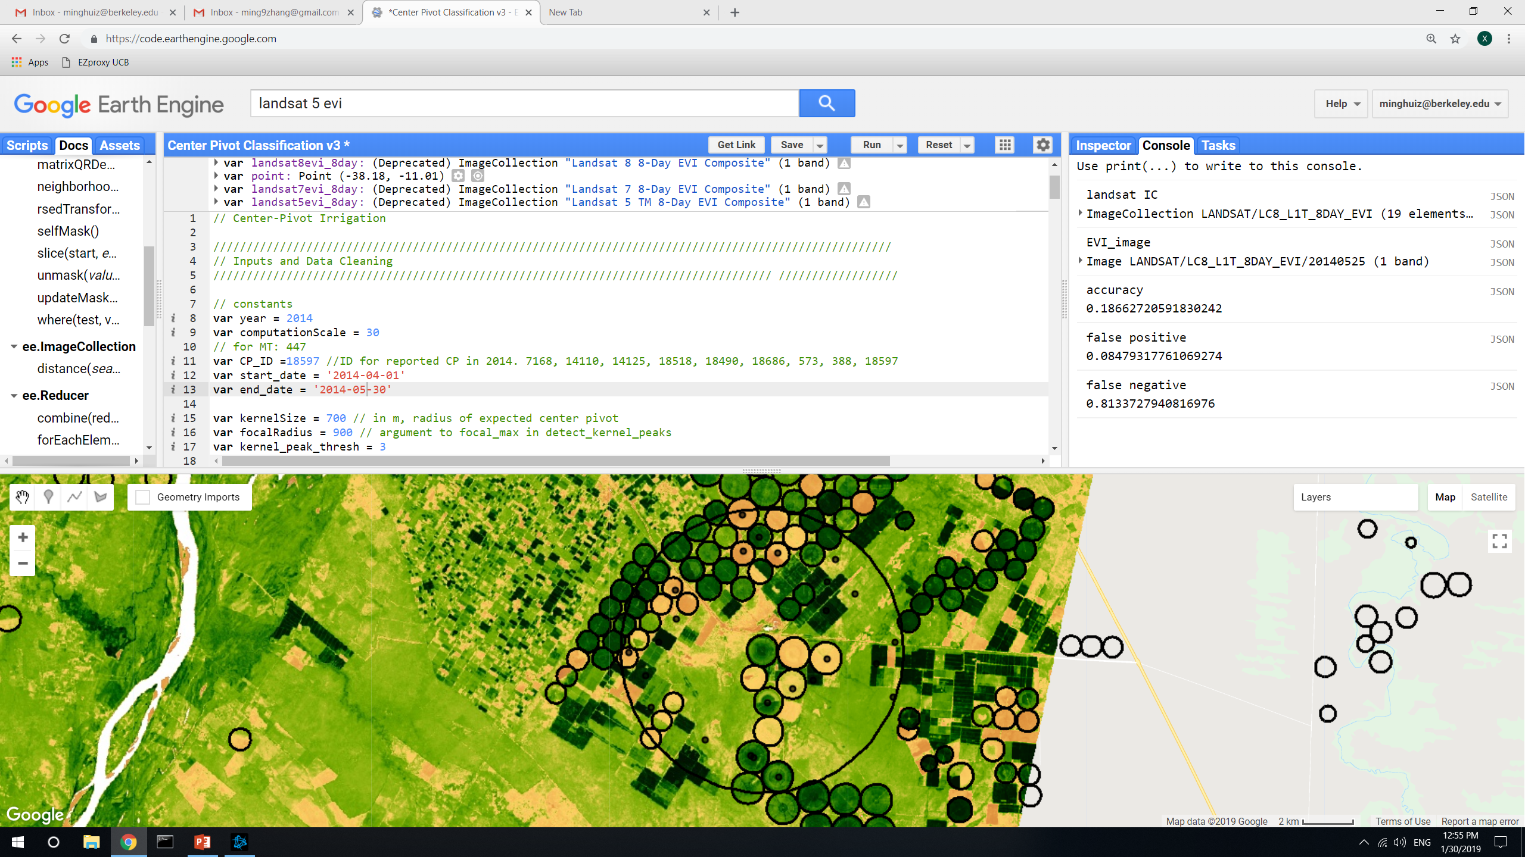
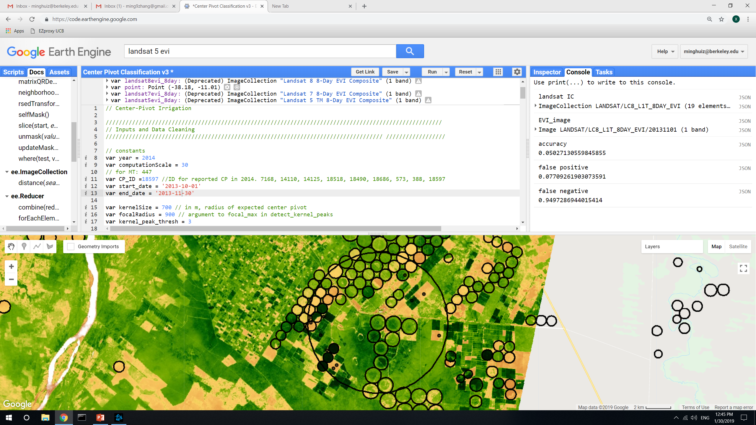
Center pivot detection: the effect of using different EVI composite dates
For these, took out map3 nonagri in both reported CP and detected CP. Accuracy is in terms of area
A lot of center pivots have never been detected using images throughout the year -> high false negative
The false positive is low here because a lot of the detected places are masked out by map3 nonagri
Composite date | Accuracy (area) | False positive (area) | False negative (area)
8/1/2013 | 0.05 | 0.065 | 0.95
10/8/2013 | 0.027 | 0.065 | 0.97
11/1/2013 | 0.05 | 0.077 | 0.95
2/2/2014 | 0.08 | 0.077 | 0.92
5/25/2014 | 0.18 | 0.08 | 0.8
6/18/2014 | 0.15 | 0.07 | 0.85
8/1/2013
10/8/2013
1/25/2014
6/18/2014
2/2/2014
5/25/2014
11/1/2013
In GEE: LandCover/Center Pivot Classification v3

Slide 5
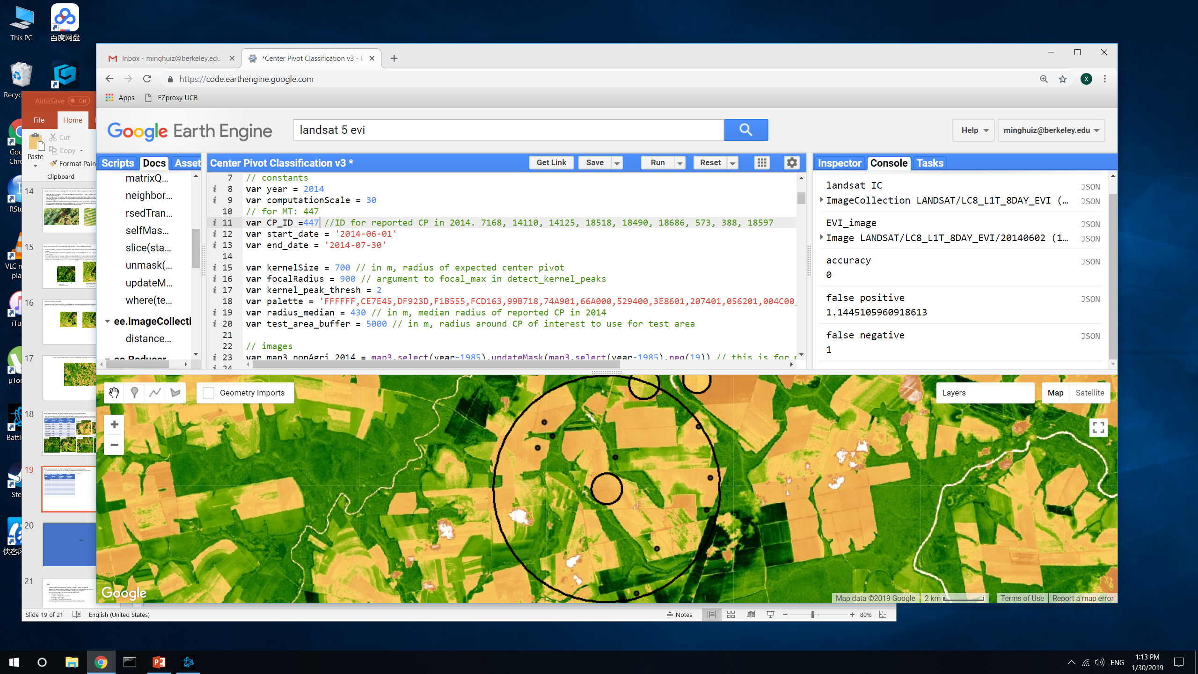
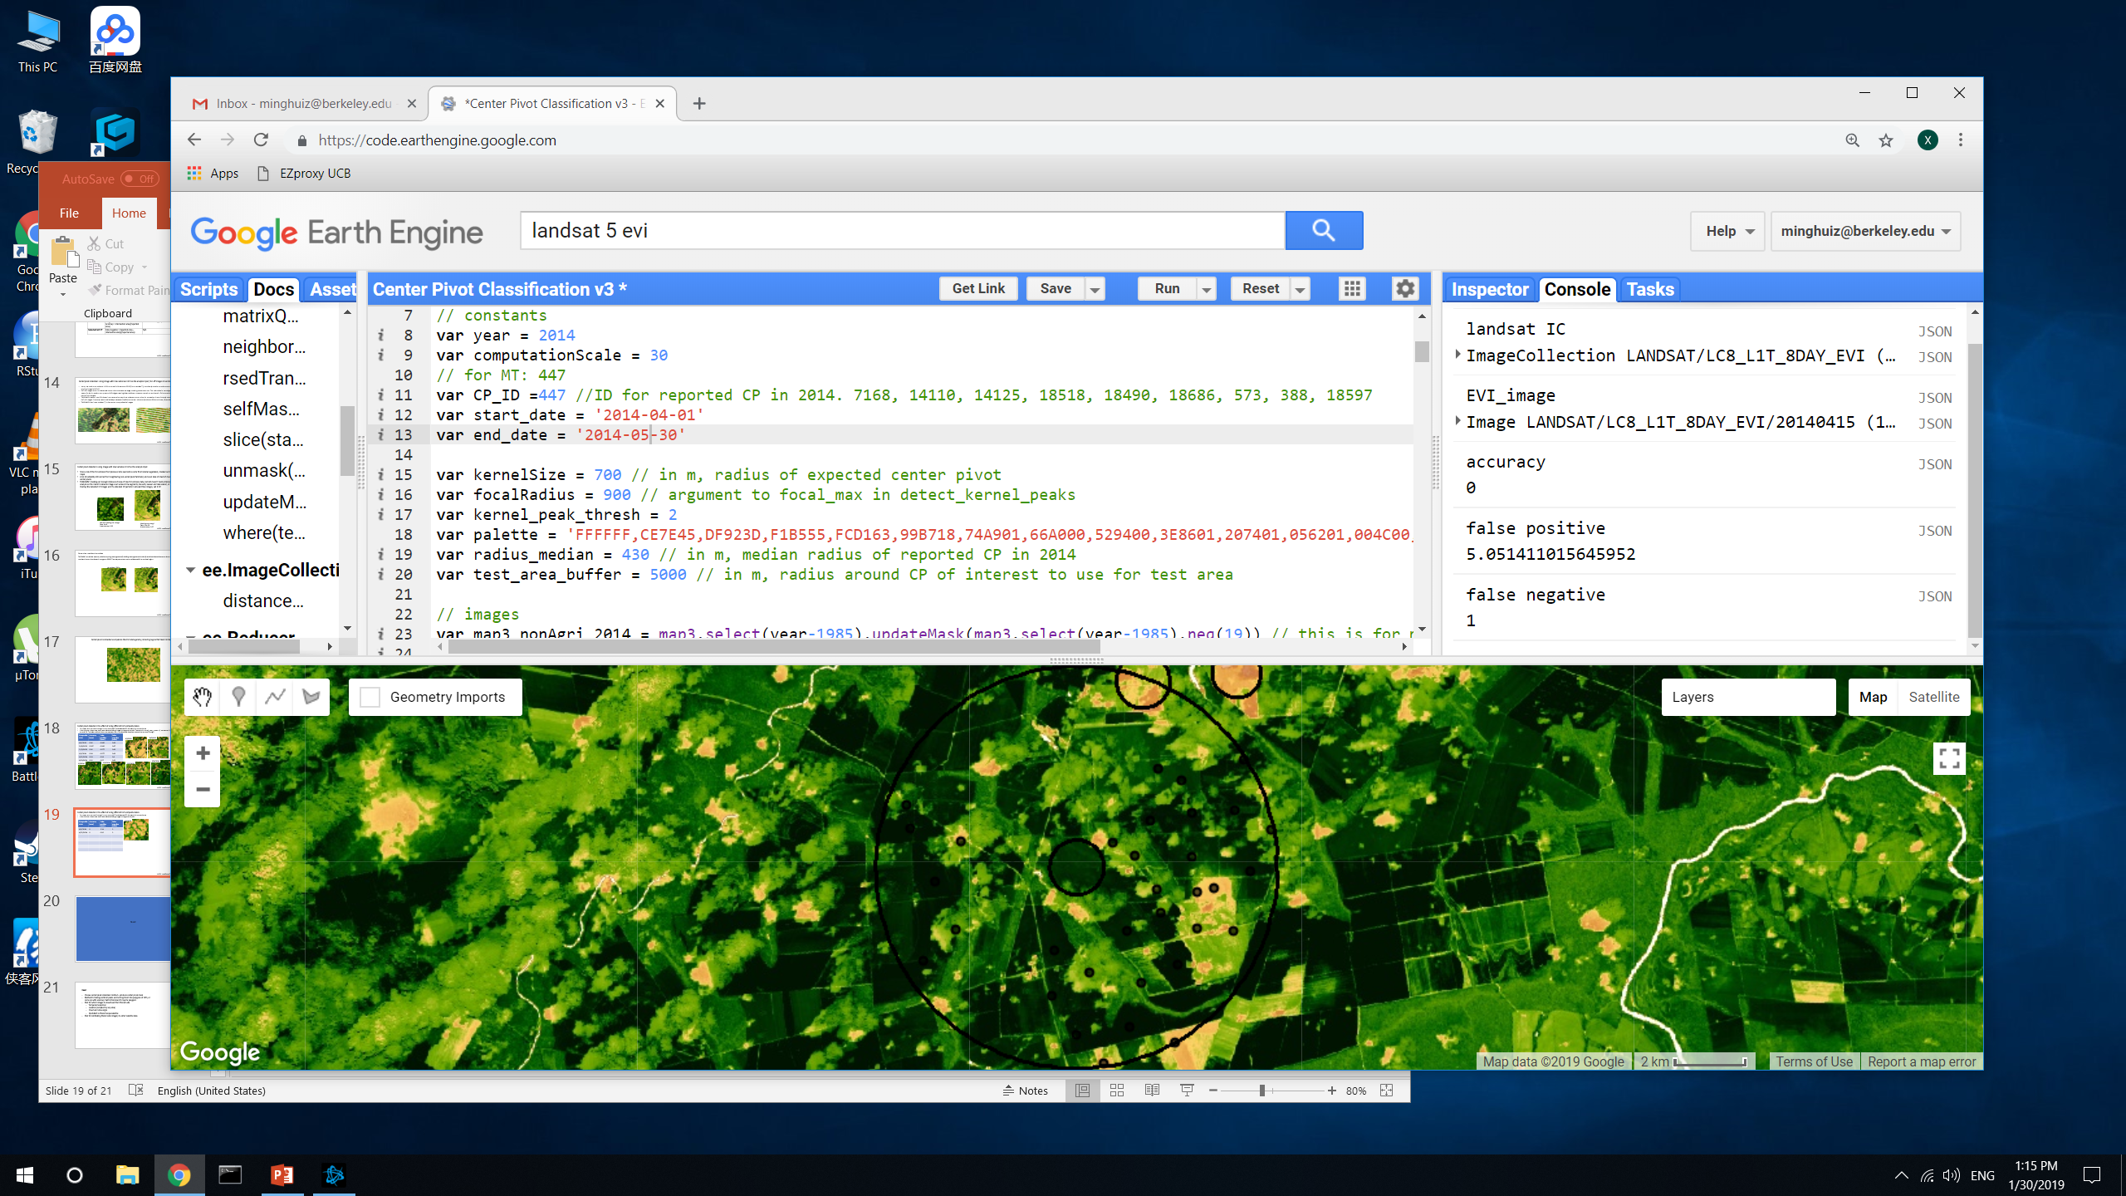
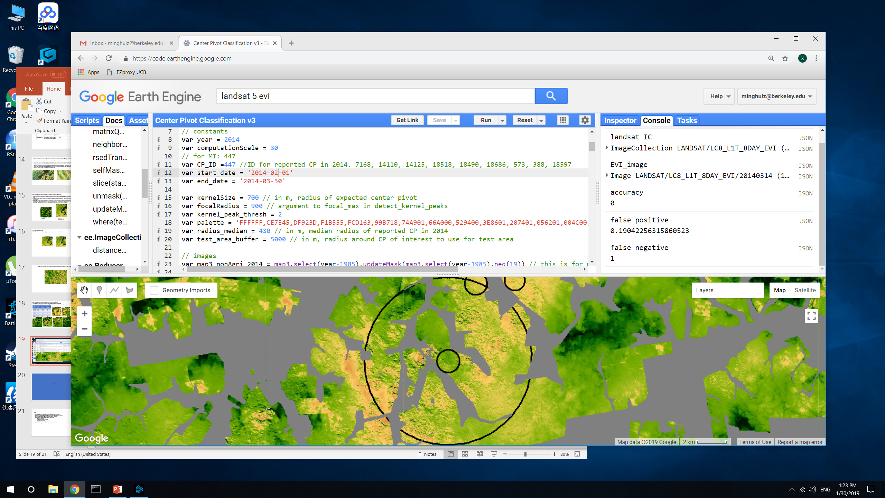
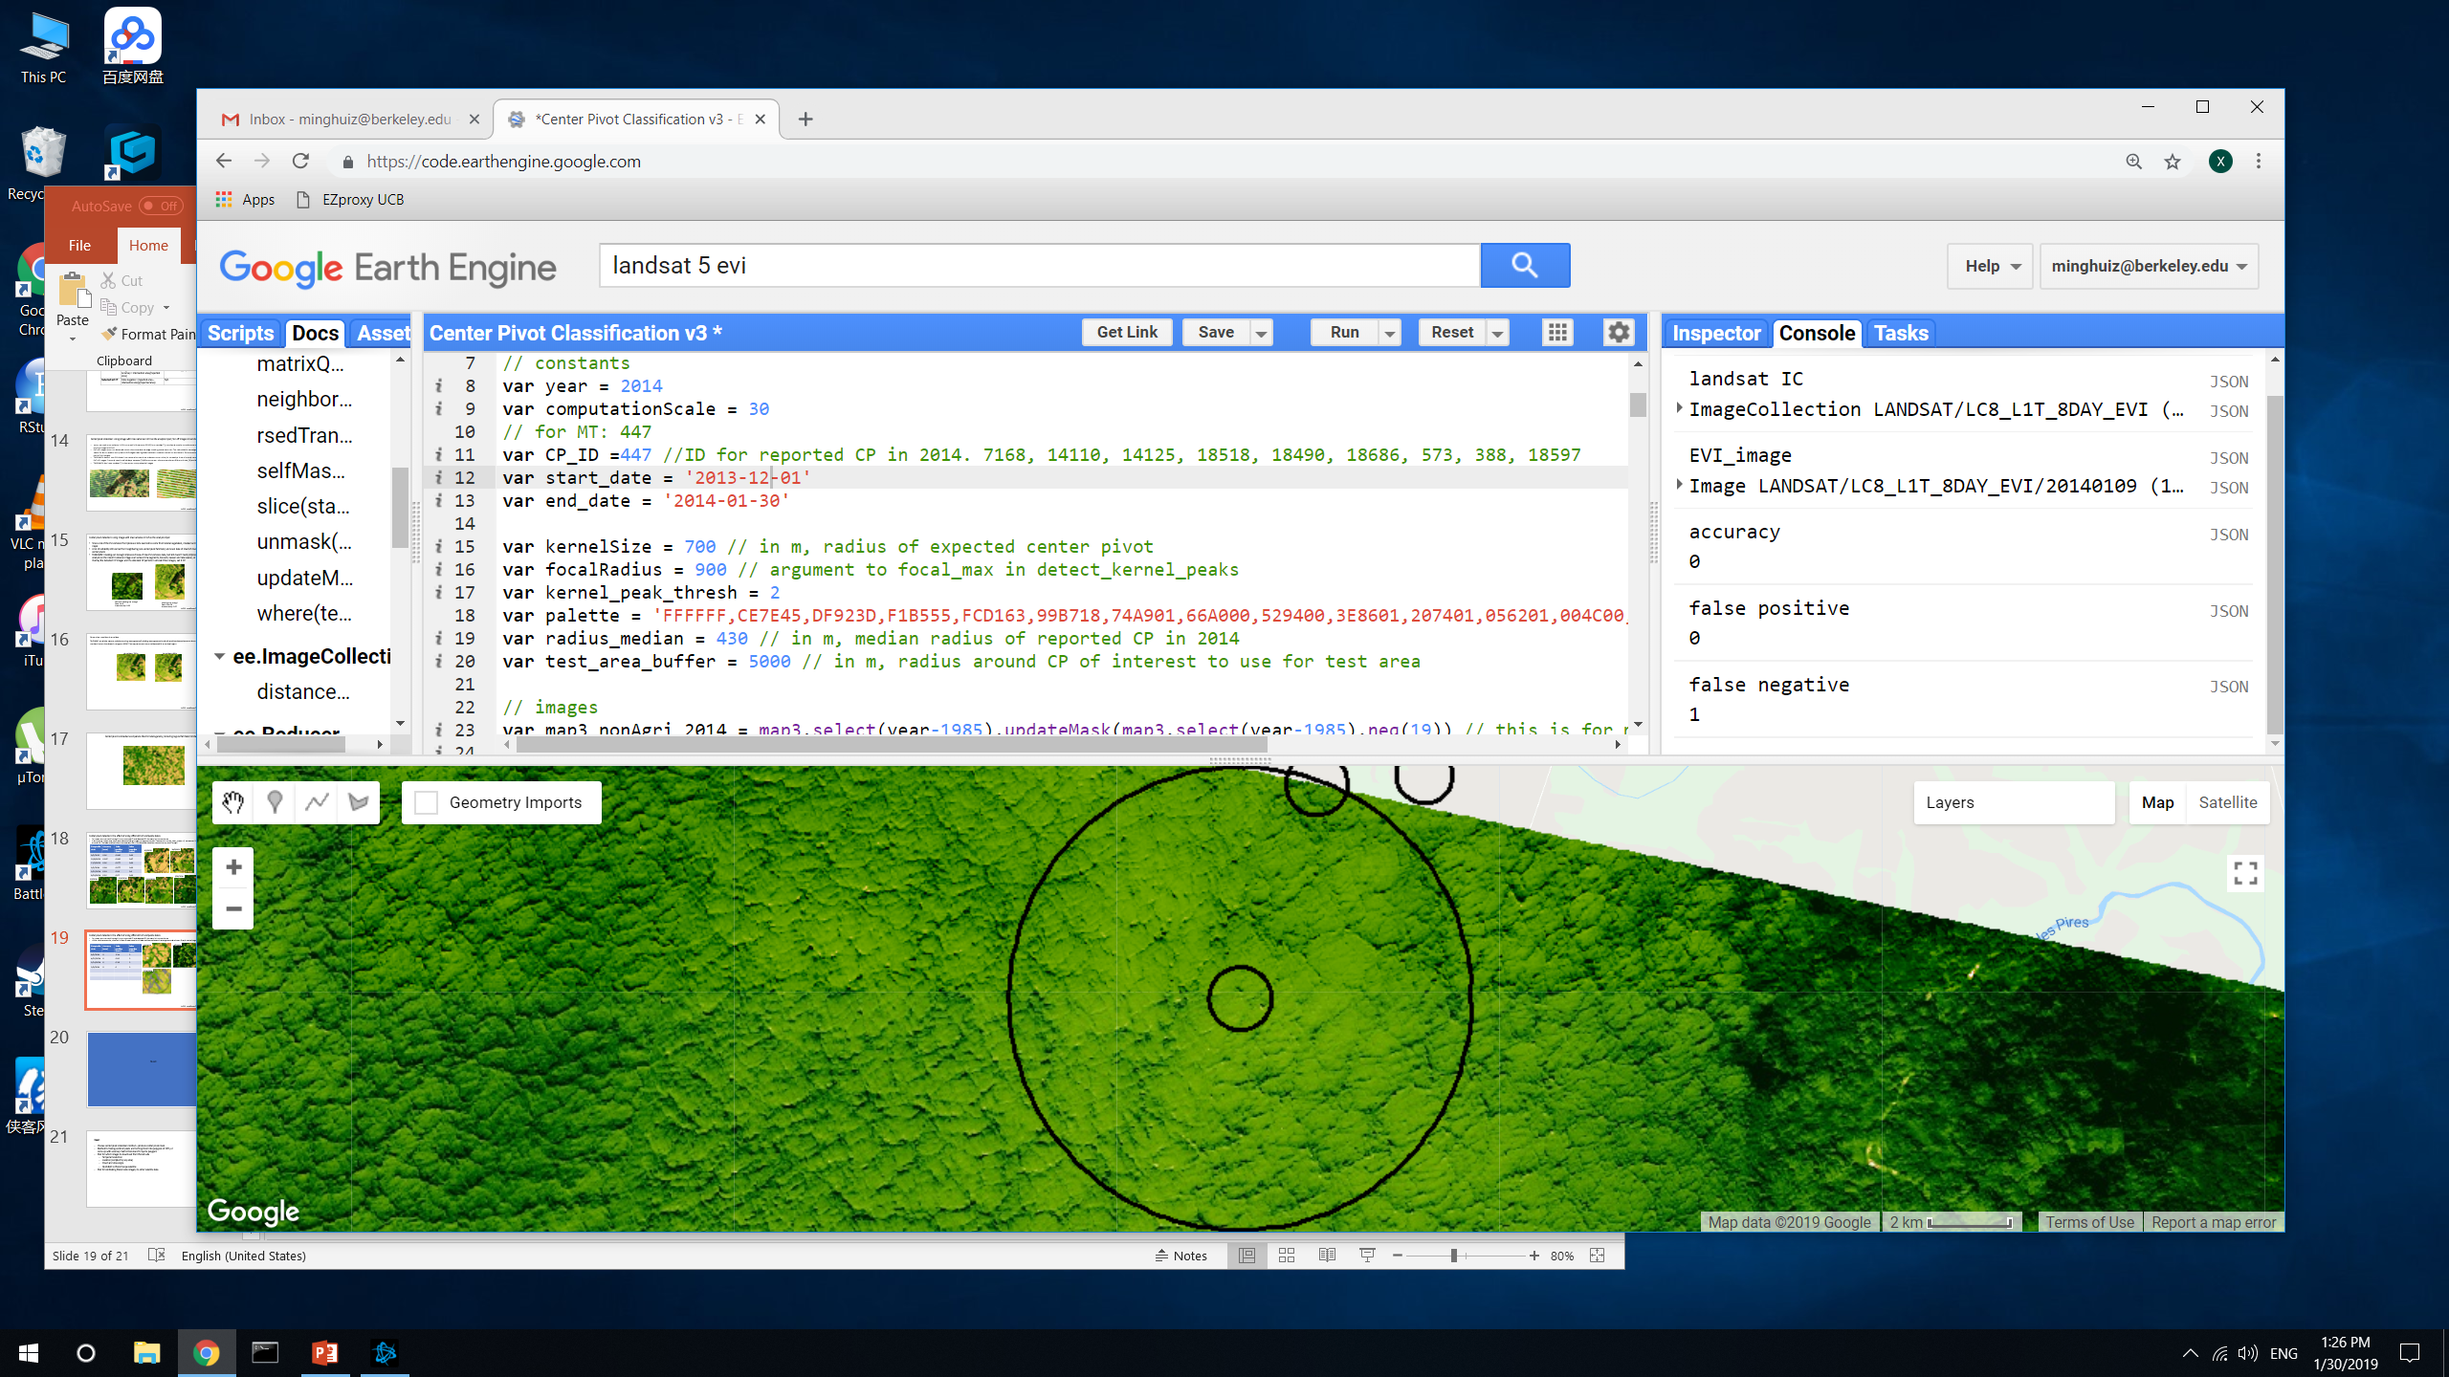
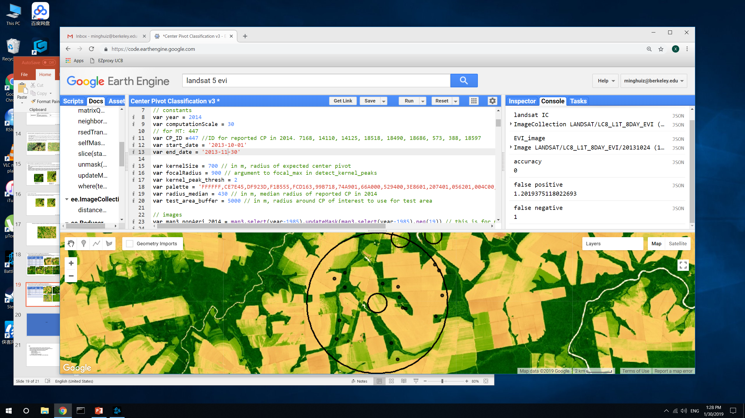
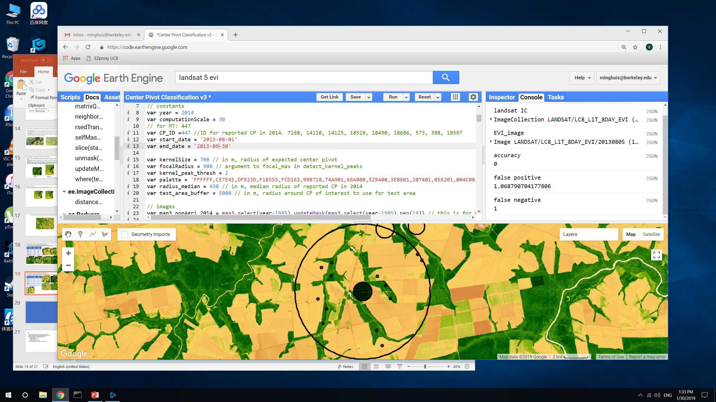
Center pivot detection: the effect of using different EVI composite dates
Unlike previous example, this area in Mato Grosso has a lot of false positives because of heterogeneous agricultural area.
Gray is natural vegetation, masked out.
Composite date | Accuracy (area) | False positive (area) | False negative (area)
6/2/2014 | 0 | 1.14 | 1
4/15/2014 | 0 | 5.05 | 1
3/14/2014 | 0 | 0.19 | 1
1/9/2014 | 0 | 0 | 1
10/24/2013 | 0 | 1.2 | 1
8/5/2013 | 0 | 1.1 | 1
6/2/2014
4/5/2014
3/14/2014
1/9/2014
10/24/2013
8/5/2013
In GEE: LandCover/Center Pivot Classification v3

Slide 6
Center pivot detection: other challenges
If overlay areas that are consistently classified as center pivot over the course of the year to gain ‘confidence’ in the result, it won’t work because the unique color of center pivots is only obvious for short spans of time
Scaling up from 25km2 circles to all of Brazil will be time consuming (e.g. need to figure out how to avoid false detections at edges of the image segments)
Kernel sizes are uncertain; could base kernel size off of 2014’s local center pivot radii but that would make it harder to scale up

Slide 7
Planet Labs images

Slide 8
Purpose of Planet images:
Validate timing information
high temporal resolution, more common in recent years
Validate SC vs DC soy (for places known to be soy)
Especially in Matopiba and central Brazil, which don’t have much ground data
Validate soy vs nonsoy agri (?)
If need to create training data for this from Planet, need calibrated images from a consistent set of satellites, need to calibrate with Sentinel 2
Planet images (from RapidEye and PlanetScope) are geolocated and corrected for terrain distortion but still top of atmosphere!

Slide 9
Can we assume land cover classification can tell where soy vs not soy is?
If so, can just use Jake’s land cover map to pick out soy areas in Planet Labs
If not, need to reclassify soy as a first step, or use only the CAR polys we know are soy
When SC and DC soy are combined into a single category, accuracy goes up significantly, e.g. from 70-85% to 95%. This indicates the majority of the error is due to SC vs DC soy, not soy vs nonsoy.
However, false positives for soy are very high and there are very few training points to improve it
Year | Accuracy | True positive | False positive
2014 | 95 | 453/(453+17) | 7/(11 + 7)
2003 | 92 | 348/(348+13) | 16/(14+16)
2004 | 90 | 324/(324+23) | 10/11
2007 | 96 | 397/(397 + 2) | 14/(14+7)
2017 | 96 | 412/(412 + 8) | 9/(9+8)
For now, downloaded Planet images over CAR polygons from Matopiba survey that are known to be soy
Validates Matopiba survey’s reported crop timing (some have suspiciously consistent planting dates across years)
Provides extra SC/DC training points in Matopiba
Set up workflow for creating validation data

Slide 10
Next:
Connect Planet to GEE (learn Python API)
Produce validation dataset out of this month’s image downloads (SC vs DC; planting and harvest date)
Plan for calibrating Planet Labs imagery to other satellite data

